Slide 1

Light Detector
Presented By:
Camille Bouvet
Saddam Hussain

Slide 2
Thermal Detector
Thermal Detector have an absorption layer that absorb and converts light into heat, and provide an electric signal output that represent the change in absorption layer temperature.
Thermal Detector are mainly classified into
Thermopile Sensors
Bolometers
Golay Cells
Pyroelectric Sensors
Active Infrared Sensors

Slide 3
Thermopile Sensors
Thermopiles sensors are thermal detectors that utilize the see beck effects in which a thermal electromotive force is generated in proportion to the incident infrared light energy.
The features of thermopile are
Operates at room temperature
Spectral response characteristic that are not dependent on wavelength
No optical chopping is required, and voltage output can be obtained according to input energy.
Low Cost
Long Life

Slide 4
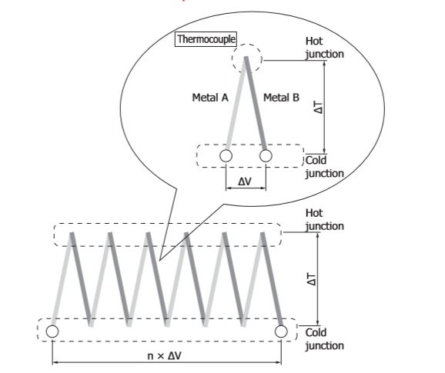
Thermopile

Slide 5
Bolometers
Bolometers are small infrared sensors that do not require cooling. When infrared enter bolometer, the bolometer resistance heat up, causing a change in its resistance. This change is converted into voltage for readout. Bolometer includes a readout circuit to minimize intrusion of external noise.

Slide 6
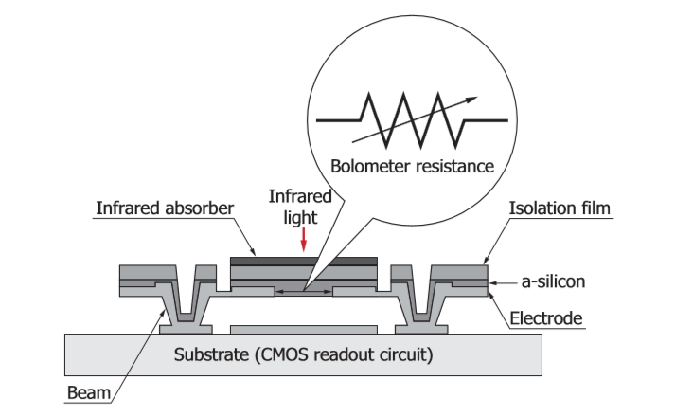
Bolometers

Slide 7
Golay Cell
The Golay cells are the broadband detectors of infrared radiation. They are extremely sensitive, but also extremely delicate. The operating principle of the cell is based on the detection of a thermal expansion of gas trapped inside an enclosure. This is why these detectors sometimes are called thermopneumatic detectors

Slide 8
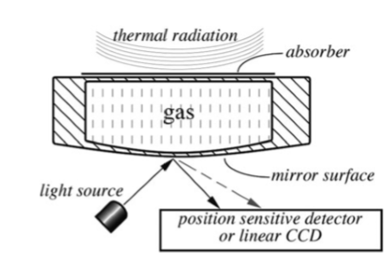
Golay Cell

Slide 9
Pyroelectric Sensors
A pyroelectric sensor belongs to a class of passive-infrared detectors (PIR) detectors. Unlike a thermopile, this sensor can be called an ac sensor as it is only responsive to a change in thermal radiation signal and not responsive to the signal magnitude.

Slide 10
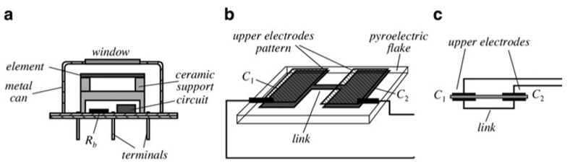
Pyroelectric Sensors

Slide 11
Active Far-Infrared Sensors
In the active far-infrared (AFIR) sensor, a process of measuring thermal radiation ﬂux is different from previously described passive-infrared detectors (PIR). Contrary to a PIR sensing element, whose temperatures depends on both the ambient and object’s temperatures, the AFIR sensor’s surface is actively controlled by a special circuit to have a deﬁned temperature Ts that in most applications is maintained constant during an entire measurement process.

Slide 12
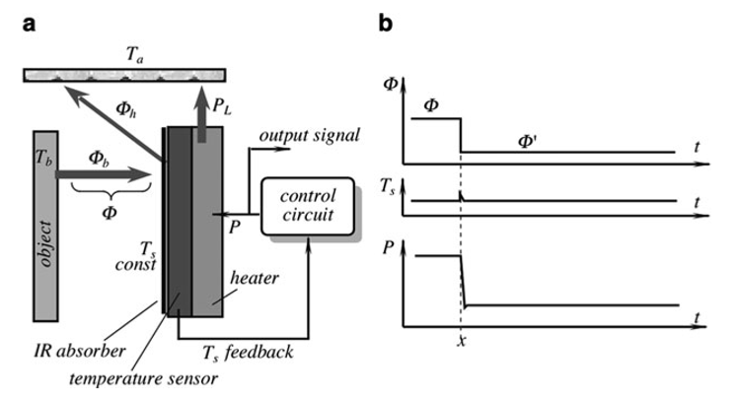
Active Far-Infrared Sensors

Slide 13
Optical Design
An optical sensor usually operates in conjunction with some kind of an optical system that may be as simple as a window or spectral ﬁlter. Often, an optical system includes lenses, mirrors, ﬁber optics, and other elements that alter direction of light. In many applications, the sensor works together with a special light source whose properties must be matched to the sensor both spectrum-wise and space-wise.

Slide 14
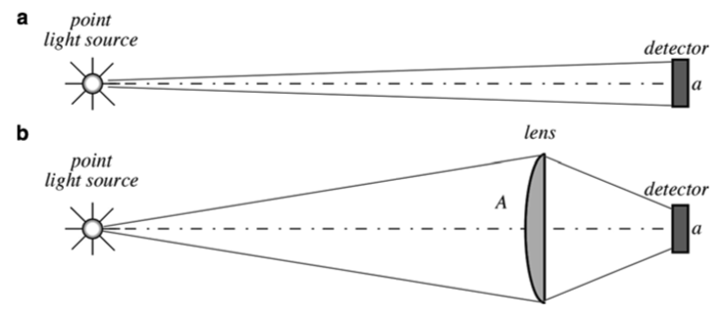
Optical Design

Slide 15
Gas Flame Detectors
To detect burning gas, it is possible to use a unique feature of the ﬂame, a noticeable portion of its optical spectrum is located in the ultraviolet (UV) spectral range. Sunlight, after passing through the atmosphere loses a large portion of its UV spectrum located below 250 nm, while a gas ﬂame contains UV components down to 180 nm. This makes it possible to design a narrow-bandwidth element for the UV spectral range that is selectively sensitive to ﬂame and not sensitive to the sunlight or electric lights.

Slide 16
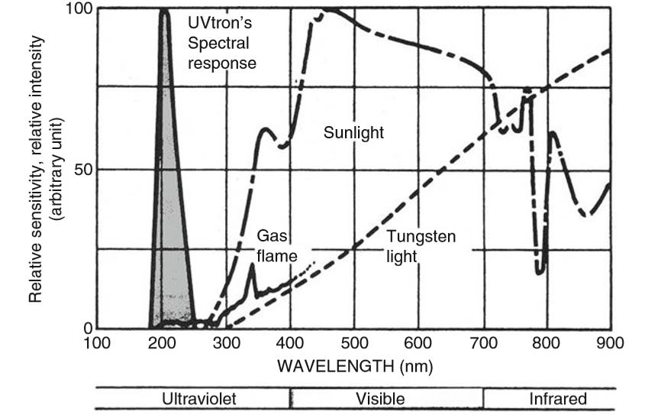
Gas Flame Detectors

Slide 17
Thanks

